Slide 1
CHAPTER 15
Simple Linear Regression and Correlation
to accompany
Introduction to Business Statistics
seventh edition, by Ronald M. Weiers
Presentation by Priscilla Chaffe-Stengel
Donald N. Stengel
© 2011 Cengage Learning.
All Rights Reserved. May not be scanned, copied, or duplicated, or posted to a publicly accessible website, in whole or in part.

Slide 2
Chapter 15 - Learning Objectives
Determine the least squares regression equation, and make point and interval estimates for the dependent variable.
Determine and interpret the value of the:
  Coefficient of correlation.
  Coefficient of determination.
Construct confidence intervals and carry out hypothesis tests involving the slope of the regression line.
© 2011 Cengage Learning.
All Rights Reserved. May not be scanned, copied, or duplicated, or posted to a publicly accessible website, in whole or in part.

Slide 3
Chapter 15 - Key Terms
Direct or inverse relationships
Least squares regression model
Standard error of the estimate, s_{y,x}
Point estimate using the regression model
Confidence interval for the mean
Prediction interval for an individual value
Coefficient of correlation
Coefficient of determination
© 2011 Cengage Learning.
All Rights Reserved. May not be scanned, copied, or duplicated, or posted to a publicly accessible website, in whole or in part.

Slide 4
Chapter 15 - Key Concept
Regression analysis generates a “best-fit” mathematical equation that can be used in predicting the values of the dependent variable as a function of the independent variable.
© 2011 Cengage Learning.
All Rights Reserved. May not be scanned, copied, or duplicated, or posted to a publicly accessible website, in whole or in part.

Slide 5
Direct vs Inverse Relationships
Direct relationship:
  As x increases, y increases.
  The graph of the model rises from left to right.
  The slope of the linear model is positive.
Inverse relationship:
  As x increases, y decreases.
  The graph of the model falls from left to right.
  The slope of the linear model is negative.
© 2011 Cengage Learning.
All Rights Reserved. May not be scanned, copied, or duplicated, or posted to a publicly accessible website, in whole or in part.

Slide 6

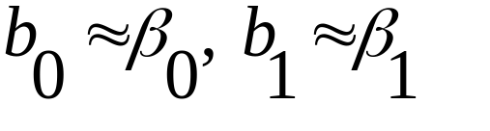
Simple Linear Regression Model
Probabilistic Model: y_{i} = β₀ + β₁x_{i} + ε_{i}
where y_{i} = a value of the dependent variable, y
x_{i} = a value of the independent variable, x
β₀ = the y-intercept of the regression line
β₁ = the slope of the regression line
ε_{i} = random error, the residual
Deterministic Model:
= b₀ + b₁x_{i} where
and is the predicted value of y in contrast to the actual value of y.
© 2011 Cengage Learning.
All Rights Reserved. May not be scanned, copied, or duplicated, or posted to a publicly accessible website, in whole or in part.

Slide 7
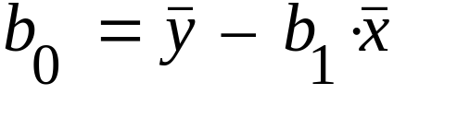
Determining the Least Squares Regression Line
Least Squares Regression Line:
  Slope
  y-intercept
ˆ
=
+
y
b
b
x
0
1
1
(
x
y
)
–
n
⋅
⋅
∑
x
y
b
=
i
i
1
(
∑
x
2
)
–
n
⋅
x
2
i
© 2011 Cengage Learning.
All Rights Reserved. May not be scanned, copied, or duplicated, or posted to a publicly accessible website, in whole or in part.

Slide 8
Simple Linear Regression:
An Example
Problem 15.9:
For a sample of 8 employees, a personnel director has collected the following data on ownership of company stock, y, versus years with the firm, x.
x 6 12 14 6 9 13 15 9
y 300 408 560 252 288 650 630 522
(a) Determine the least squares regression line and interpret its slope. (b) For an employee who has been with the firm 10 years, what is the predicted number of shares of stock owned?
© 2011 Cengage Learning.
All Rights Reserved. May not be scanned, copied, or duplicated, or posted to a publicly accessible website, in whole or in part.

Slide 9
Problem 15.9, cont.
x y x•y x²
6 300 1800 36
12 408 4896 144
14 560 7840 196
6 252 1512 36
9 288 2592 81
13 650 8450 169
15 630 9450 225
9 522 4698 81
Mean: 10.5 451.25
Sum: 41,238 968
© 2011 Cengage Learning.
All Rights Reserved. May not be scanned, copied, or duplicated, or posted to a publicly accessible website, in whole or in part.

Slide 10
Problem 15.9, cont.
Slope:
y-Intercept:
So the “best-fit” linear model, rounding to the nearest tenth, is:
(
x
y
)
–
n
⋅
x
∑
⋅
y
41238
–
8
⋅
(
10
.
5
)
⋅
i
i
(
451
.
25
)
b
=
=
=
38
.
7558
1
(
x
2
)
–
n
⋅
x
2
2
∑
i
968
−
8
⋅
(
10
.
5
)
ˆ
y
=
44
.
3140
+
38
.
7558
x
≈
44
.
3
+
38
.
8
x
© 2011 Cengage Learning.
All Rights Reserved. May not be scanned, copied, or duplicated, or posted to a publicly accessible website, in whole or in part.

Slide 11
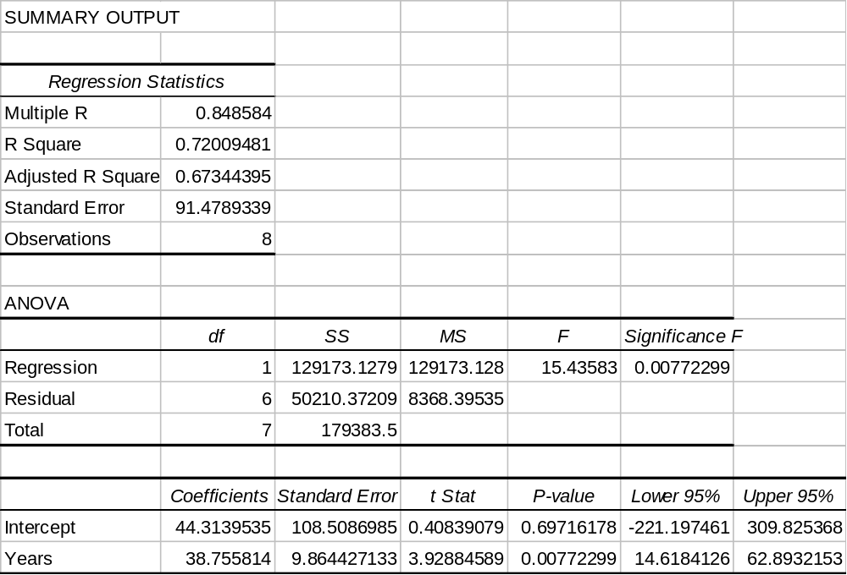
Excel Output, Problem 15.9, cont.
The square root of MSE is standard error.
MS Residual is MSE … is variance.
The y-intercept The slope
© 2011 Cengage Learning.
All Rights Reserved. May not be scanned, copied, or duplicated, or posted to a publicly accessible website, in whole or in part.

Slide 12
Problem 15.9, cont.
Interpretation of the slope: For every additional year an employee works for the firm, the employee acquires an estimated 38.8 shares of stock per year.
If x₁ = 10, the point estimate for the number of shares of stock that this employee owns is:
ˆ
y
=
44
.
314
+
38
.
7558
⋅
x
=
44
.
314
+
38
.
7558
(
10
)
⋅
=
431
.
872
≈
432
shares
© 2011 Cengage Learning.
All Rights Reserved. May not be scanned, copied, or duplicated, or posted to a publicly accessible website, in whole or in part.

Slide 13
Interval Estimates Using the
Regression Model
Confidence Interval for the Mean of y
  places an upper and lower bound around the point estimate for the average value of y given x.
Prediction Interval for an Individual y
  places an upper and lower bound around the point estimate for an individual value of y given x.
© 2011 Cengage Learning.
All Rights Reserved. May not be scanned, copied, or duplicated, or posted to a publicly accessible website, in whole or in part.

Slide 14
To Form Interval Estimates
The Standard Error of the Estimate, s_{y,x}
  The standard deviation of the distribution of the
    data points above and below the regression line,
    distances between actual and predicted values of y,
    residuals, of ε
  The square root of MSE given by ANOVA
(
y
–
ˆ
2
∑
y
)
s
=
i
y
,
x
n
–
2
© 2011 Cengage Learning.
All Rights Reserved. May not be scanned, copied, or duplicated, or posted to a publicly accessible website, in whole or in part.

Slide 15
Equations for the Interval Estimates
Confidence Interval for the Mean of y
Prediction Interval for the Individual y
1
(
x
value
–
x
)
2
ˆ
±
⋅
⋅
+
y
t
α
(
s
y
,
x
)
n
2
2
(
∑
x
)
(
∑
x
2
)
–
i
i
n
(
x
value
–
x
2
ˆ
±
⋅
⋅
+
1
+
)
y
t
α
(
s
y
,
x
)
1
n
2
2
(
∑
x
)
(
∑
x
2
)
–
i
i
n
© 2011 Cengage Learning.
All Rights Reserved. May not be scanned, copied, or duplicated, or posted to a publicly accessible website, in whole or in part.

Slide 16
Using Intervals – Problem 15.9
For employees who worked 10 years for the firm, what is the 95% confidence interval for their mean share holdings?
This calls for a confidence interval on the average number of shares owned by employees who worked for the firm 10 years. So we will use:
1
(
x
value
–
x
)
2
ˆ
±
⋅
⋅
+
y
t
α
s
y
,
x
n
2
(
∑
x
)
2
(
∑
x
2
)
–
n
© 2011 Cengage Learning.
All Rights Reserved. May not be scanned, copied, or duplicated, or posted to a publicly accessible website, in whole or in part.

Slide 17
Standard Error of the Estimate, Definitional Equation
x y Predicted y Squared Residual
6 300 276.8488 535.9763
12 408 509.3837 10278.6589
14 560 586.8953 723.3598
6 252 276.8488 617.4647
9 288 393.1163 11049.4321
13 650 548.1395 10375.5544
15 630 625.6512 18.9124
9 522 393.1163 16611.0135
Sum = 50210.3721
© 2011 Cengage Learning.
All Rights Reserved. May not be scanned, copied, or duplicated, or posted to a publicly accessible website, in whole or in part.

Slide 18
Evaluating the Confidence Interval
2
Since n = 8, df = 8 – 2 = 6 and t_{α/2} = 2.447. From our prior analyses, Σx = 84, Σx² = 968, and the predicted y = 431.872.
(
y
–
ˆ
∑
y
)
50
,
210
.
3721
s
=
i
=
=
91
.
4789
y
,
x
n
–
2
8
–
2
1
(
x
value
–
x
)
2
ˆ
±
⋅
⋅
+
=
y
t
α
s
y
,
x
n
(
∑
x
)
2
2
(
∑
x
2
)
–
n
1
(
10
–
10
.
5
)
2
431
.
872
±
(
2
.
447
)
⋅
(
91
.
4789
)
⋅
+
=
8
84
2
968
–
8
431
.
872
±
(
2
.
447
)
⋅
(
91
.
4789
)
⋅
(
0
.
3576
)
=
431
.
872
±
80
.
057
© 2011 Cengage Learning.
All Rights Reserved. May not be scanned, copied, or duplicated, or posted to a publicly accessible website, in whole or in part.

Slide 19
Interpreting the Confidence Interval
Based on our calculations, we would have 95% confidence that the mean number of shares for persons working for the firm 10 years will be between:
431.872 – 80.057 = 351.815
and
431.872 + 80.057 = 511.929
Written in interval notation:
(351.815, 511.929)
© 2011 Cengage Learning.
All Rights Reserved. May not be scanned, copied, or duplicated, or posted to a publicly accessible website, in whole or in part.

Slide 20
Using Intervals – Problem 15.9
An employee worked 10 years for the firm. What is the 95% prediction interval for her share holdings?
This calls for a prediction interval on the number of shares owned by an individual employee who worked for the firm 10 years. So we will use:
1
(
x
value
–
x
)
2
ˆ
±
⋅
⋅
+
+
y
t
α
s
y
,
x
1
n
2
(
∑
x
)
2
(
∑
x
2
)
–
n
© 2011 Cengage Learning.
All Rights Reserved. May not be scanned, copied, or duplicated, or posted to a publicly accessible website, in whole or in part.

Slide 21
Evaluating the Prediction Interval - Problem 15.9
Since n = 8, df = 8 – 2 = 6 and t_{α/2} = 2.447. From our prior analyses, Σx = 84, Σx² = 968, and the predicted y = 431.872.
1
(
x
value
–
x
)
2
ˆ
±
⋅
⋅
+
+
=
y
t
α
s
y
,
x
1
n
2
(
∑
x
)
2
(
∑
x
2
)
–
n
1
(
10
–
10
.
5
)
2
431
.
872
±
(
2
.
447
)
⋅
(
91
.
4789
)
⋅
1
+
+
=
8
84
2
968
–
8
431
.
872
±
(
2
.
447
)
⋅
(
91
.
4789
)
⋅
(
1
.
0620
)
=
431
.
872
±
237
.
734
© 2011 Cengage Learning.
All Rights Reserved. May not be scanned, copied, or duplicated, or posted to a publicly accessible website, in whole or in part.

Slide 22
Interpreting the Prediction Interval –
Problem 15.9
Based on our calculations, we would have 95% confidence that the number of shares an employee working for the firm 10 years will hold will be between:
431.872 – 237.734 = 194.138
and
431.872 + 237.734 = 669.606
Written in interval notation,
(194.138 , 669.606)
© 2011 Cengage Learning.
All Rights Reserved. May not be scanned, copied, or duplicated, or posted to a publicly accessible website, in whole or in part.

Slide 23
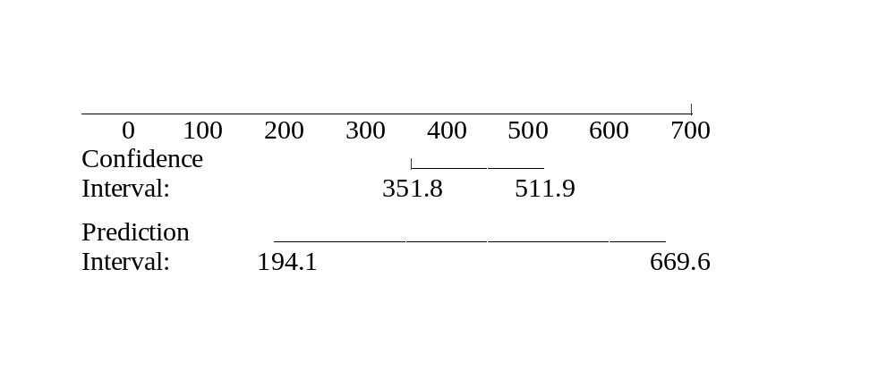

Comparing the Two Intervals
Notice that the confidence interval for the mean is much narrower than the prediction interval for the individual value. There is greater fluctuation among individual values than among group means. Both are centered at the point estimate. = 431.872
© 2011 Cengage Learning.
All Rights Reserved. May not be scanned, copied, or duplicated, or posted to a publicly accessible website, in whole or in part.

Slide 24
Coefficient of Correlation
A measure of the
  Direction of the linear relationship between x and y.
    If x and y are directly related, r > 0.
    If x and y are inversely related, r < 0.
  Strength of the linear relationship between x and y.
    The larger the absolute value of r, the more the value of y depends in a linear way on the value of x.
© 2011 Cengage Learning.
All Rights Reserved. May not be scanned, copied, or duplicated, or posted to a publicly accessible website, in whole or in part.

Slide 25
Coefficient of Determination
A measure of the
  Strength of the linear relationship between x and y.
    The larger the value of r², the more the value of y depends in a linear way on the value of x.
  Amount of variation in y that is related to variation in x.
  Ratio of variation in y that is explained by the regression model divided by the total variation in y.
© 2011 Cengage Learning.
All Rights Reserved. May not be scanned, copied, or duplicated, or posted to a publicly accessible website, in whole or in part.

Slide 26
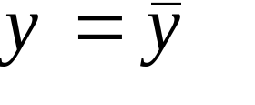
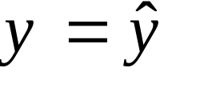
Testing for Linearity
Key Argument:
If the value of y does not change linearly with the value of x, then using the mean value of y is the best predictor for the actual value of y. This implies is preferable.
If the value of y does change linearly with the value of x, then using the regression model gives a better prediction for the value of y than using the mean of y. This implies is preferable.
© 2011 Cengage Learning.
All Rights Reserved. May not be scanned, copied, or duplicated, or posted to a publicly accessible website, in whole or in part.

Slide 27
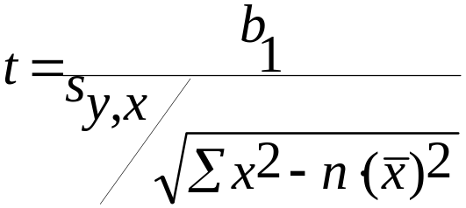
Three Tests for Linearity
1. Testing the Coefficient of Correlation
H₀: ρ = 0 There is no linear relationship between x and y.
H₁: ρ ≠ 0 There is a linear relationship between x and y.
Test Statistic:
2. Testing the Slope of the Regression Line
H₀: β₁ = 0 There is no linear relationship between x and y.
H₁: β₁ ≠ 0 There is a linear relationship between x and y.
Test Statistic:
t
=
r
1
–
r
2
n
–
2
© 2011 Cengage Learning.
All Rights Reserved. May not be scanned, copied, or duplicated, or posted to a publicly accessible website, in whole or in part.

Slide 28
Three Tests for Linearity
3. The Global F-test
H₀: There is no linear relationship between x and y.
H₁: There is a linear relationship between x and y.
Test Statistic:
Note: At the level of simple linear regression, the global F-test is equivalent to the t-test on β₁. When we conduct regression analysis of multiple variables, the global F-test will take on a unique function.
SSR
F
=
MSR
=
1
MSE
SSE
(
n
–
2
)
© 2011 Cengage Learning.
All Rights Reserved. May not be scanned, copied, or duplicated, or posted to a publicly accessible website, in whole or in part.

Slide 29
Excel Output, Problem 15.9
The global F test statistic for the test of H₀: β₁ = 0
Coefficient of correlation
Coefficient of determination
Note that:
(1) both t and F have the same p-value, and
(2) t² = F.
The calculated t for the test of H₀: β₁ = 0
© 2011 Cengage Learning.
All Rights Reserved. May not be scanned, copied, or duplicated, or posted to a publicly accessible website, in whole or in part.

Slide 30
A General Test of β₁
Testing the Slope of the Population Regression Line Is Equal to a Specific Value.
H₀: β₁ = β₁₀
The slope of the population regression line is β₁₀.
H₁: β₁ ≠ β₁₀
The slope of the population regression line is not β₁₀.
Test Statistic:
b
–
β
t
=
1
10
s
y
,
x
x
2
–
n
(
x
)
2
∑
© 2011 Cengage Learning.
All Rights Reserved. May not be scanned, copied, or duplicated, or posted to a publicly accessible website, in whole or in part.

